Slide 1
Performance Monitoring

Slide 2
Rationale and Issues
Performance inefficiencies are multiplied on a parallel computer
The purpose of performance monitoring:
Elimination of performance degradation sources
Providing acceptable utilization of hardware resources
Verification that optimization yields the expected results (sanity check)
Measurements impact program execution
The more invasive the instrumentation, the bigger the discrepancies
Program execution flow may be impacted in extreme cases
Overheads may be reduced through sampling
Many CPUs provide hardware support enabling event counting with extremely low overheads

Slide 3
Select Proprietary Tools
Intel VTune Amplifier
Targets multithreaded execution on the x86 line of CPUs and Xeon Phi
Profiling, hotspot analysis, memory usage and storage accesses, Flops and FPU utilization measurement, offload tracing via OpenCL
Integrated with Parallel Studio XE and Microsoft Visual Studio
Supported languages: C, C++, C#, Fortran, Java, Go, Python, assembly
AMD CodeXL
Supports x86-compatible CPUs as well as AMD GPUs and APUs
Time based profiling on CPUs, event based profiling and instruction based sampling on CPUs and APUs, real-time power profiling
Available as a standalone version and as an extension to MS Visual Studio
Nvidia visual profiler from CUDA Toolkit (nvvp)
Trace based tool
Execution timeline decomposed into individual threads and workload phases
Captures memory usage, power consumption, clock speed, thermal state
Monitors Pthreads on host CPU as well as OpenACC applications via PGI compiler
Available for Linux, OS X, and Windows

Slide 4
Time Measurement: Command Line Tools
“Date” utility
Single second accuracy, useful for coarse time stamps
“Time” utility
Captures actual duration of command execution as well as user and system time in seconds (bash shell built-in)
System version provides CPU utilization, memory usage, I/O, and page fault counts in addition to data output by bash command
> date
Sun, Feb 05, 2017 6:17:33 PM
> /usr/bin/time sleep 2
0.00user 0.04system 0:02.04elapsed 2%CPU (0avgtext+0avgdata 422144maxresident)k
0inputs+0outputs (1737major+0minor)pagefaults 0swaps

Slide 5
Time Measurement: API
POSIX high-resolution clocks
A number of clocks of different properties provided by the OS
Monotonic clocks (CLOCK_MONOTONIC or CLOCK_MONOTONIC_RAW) most useful for program monitoring
Struct timespec contains fields tv_sec and tv_nsec storing the number of full seconds and nanoseconds (respectively) elapsed from certain fixed point in the past
The actual clock resolution may be retrieved by
#include <time.h>
int clock_gettime(clockid_t id, struct timespec *tsp);
int clock_getres(clockid_t id, struct timespec *tsp);

Slide 6
Example: Matrix-Vector Multiply
001 #include <stdio.h>
002 #include <stdlib.h>
003 #include <cblas.h>
004 #include <time.h>
005
006 void init(int n, double **m, double **v, double **p, int trans) {
007 *m = calloc(n*n, sizeof(double));
008 *v = calloc(n, sizeof(double));
009 *p = calloc(n, sizeof(double));
010 for (int i = 0; i < n; i++) {
011 (*v)[i] = (i & 1)? -1.0: 1.0;
012 if (trans) for (int j = 0; j <= i; j++) (*m)[j*n+i] = 1.0;
013 else for (int j = 0; j <= i; j++) (*m)[i*n+j] = 1.0;
014 }
015 }
016
017 void mult(int size, double *m, double *v, double *p, int trans) {
018 int stride = trans? size: 1;
019 for (int i = 0; i < size; i++) {
020 int mi = trans? i: i*size;
021 p[i] = cblas_ddot(size, m+mi, stride, v, 1);
022 }
023 }

Slide 7
Example: Matrix-Vector Multiply (cont.)
025 double sec(struct timespec *ts) {
026 return ts->tv_sec+1e-9*ts->tv_nsec;
027 }
028
029 int main(int argc, char **argv) {
030 struct timespec t0, t1, t2, t3, t4;
031 clock_gettime(CLOCK_MONOTONIC, &t0);
032 int n = 1000, trans = 0;
033 if (argc > 1) n = strtol(argv[1], NULL, 10);
034 if (argc > 2) trans = (argv[2][0] == 't');
035
036 double *m, *v, *p;
037 clock_gettime(CLOCK_MONOTONIC, &t1);
038 init(n, &m, &v, &p, trans);
039 clock_gettime(CLOCK_MONOTONIC, &t2);
040 mult(n, m, v, p, trans);
041 clock_gettime(CLOCK_MONOTONIC, &t3);
042 double s = cblas_dasum(n, p, 1);
043 clock_gettime(CLOCK_MONOTONIC, &t4);
044 printf("Size %d; abs. sum: %f (expected: %d)\n", n, s, (n+1)/2);
045 printf("Timings:\n program: %f s\n", sec(&t4)-sec(&t0));
046 printf(" init: %f s\n mult: %f s\n sum: %f s\n",
047 sec(&t2)-sec(&t1), sec(&t3)-sec(&t2), sec(&t4)-sec(&t3));
048 return 0;
049 }

Slide 8
Example: Matrix-Vector Multiply Output
20000x20000 matrix, row-major mode
20000x20000 matrix, column-major mode

Slide 9
Application Profiling
Identifies potential performance issues
Hotspots
Parts of code the program spends most time executing
Bottlenecks
Hotspots that have adverse impact on program execution
Optimizations may move them to other parts of code
Instrumentation: program modification permitting collection of performance data
Manual (performed by the programmer)
Automated (performed by the compiler, library or external tool)
Profiling data may be collected in user space, kernel space or both

Slide 10
Common Profiling Metrics
Memory related
Total memory, physical memory, shared memory
Size of program heap, stack or text segment
I/O related
Number of input or output operations
Total amount of data transferred (read and write)
Data bandwidth (peak, average)
Number of files opened
Communication
Number and size of messages sent or received
Achieved latency and bandwidth
Further categorization by network, endpoint type, and protocol

Slide 11
Main Performance Classes
Compute (or CPU) bound
Execution time is dominated by processor speed
Memory bound
Duration of execution determined by amount of memory used
I/O bound
The most significant fraction of program time is spent performing input/output operations

Slide 12
gperftools
Originally Google Performance Tools
Currently community maintained
Includes statistical profiling tool, gprof
Additional tools accompanying thread-caching malloc library (tcmalloc)
Memory leak detection
Dynamic memory allocation profiling

Slide 13
Gperf Example
Compilation and linking
Invocation
Display of results

Slide 14
Memory Monitoring Examples
Leak detection
Monitoring of memory allocation

Slide 15
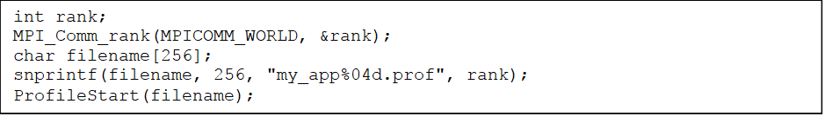
Instrumentation of MPI Applications
Profile data must be written to a dedicated file for each process
Instrumentation requires addition of the following statement following MPI_Init (filename must be different for each process)
Example code accomplishing this
ProfilerStart(filename);

Slide 16
Hardware Events with Perf
Also referred to as perf_events
Integrated with Linux kernel (sys_event_perf_open system call)
Hardware event categories:
Cache misses and accesses issued (for L1, L2, and L3 caches) with instruction/data and load/store grouping
TLB related (categorized into instruction/data and load/store access types)
Branch statistics (branch occurrence, mispredicted branch counts)
Cycle (total, stalled, and idle) and instruction (issued, retired) counts
Node-level prefetches, loads, and stores
“uncore” events, collected by CPU logic shared by all cores (memory controller and NUMA related, last level cache accesses, coherency traffic, power)
Kernel software events
Context switches and migrations, alignment faults, page faults, BPF events

Slide 17
Perf Usage
perf <command> [<application> <arguments>]
where supported commands are:
list: outputs events supported on local platform
stat: profiles specified application
record: enables per thread, per process or per CPU profiling
report: performs analysis of recorded data
annotate: correlates profiling data to assembly code
top: displays statistics in real time for a running application
bench: runs tests using predefined benchmark kernels

Slide 18
Perf Example (I)
Matrix-vector multiplication, row-major
> perf stat ./mvmult 20000
Size 20000; abs. sum: 10000.000000 (expected: 10000)
Performance counter stats for './mvmult 20000':
1219.404556 task-clock (msec) # 1.000 CPUs utilized
1 context-switches # 0.001 K/sec
0 cpu-migrations # 0.000 K/sec
781,490 page-faults # 0.641 M/sec
3,898,266,727 cycles # 3.197 GHz
2,283,166,328 stalled-cycles-frontend # 58.57% frontend cycles idle
1,372,252,385 stalled-cycles-backend # 35.20% backend cycles idle
3,764,331,355 instructions # 0.97 insns per cycle
# 0.61 stalled cycles per insn
495,220,268 branches # 406.116 M/sec
815,338 branch-misses # 0.16% of all branches
1.219967824 seconds time elapsed

Slide 19
Perf Example (II)
Matrix-vector multiplication, column-major
Performance counter stats for './mvmult 20000 t':
12212.530334 task-clock (msec) # 1.000 CPUs utilized
11 context-switches # 0.001 K/sec
0 cpu-migrations # 0.000 K/sec
1,213,417 page-faults # 0.099 M/sec
42,933,883,759 cycles # 3.516 GHz
39,567,001,587 stalled-cycles-frontend # 92.16% frontend cycles idle
37,181,761,140 stalled-cycles-backend # 86.60% backend cycles idle
6,077,067,370 instructions # 0.14 insns per cycle
# 6.51 stalled cycles per insn
918,790,187 branches # 75.233 M/sec
1,276,503 branch-misses # 0.14% of all branches
12.213751102 seconds time elapsed

Slide 20
Perf Example (III)
Matrix-vector multiplication, custom events
> perf stat -B -e cache-misses,dTLB-load-misses,iTLB-load-misses ./mvmult 20000
Size 20000; abs. sum: 10000.000000 (expected: 10000)
Performance counter stats for './mvmult 20000':
29,307,244 cache-misses
3,121,156 dTLB-load-misses
4,224 iTLB-load-misses
1.227144489 seconds time elapsed
Row-major
Performance counter stats for './mvmult 20000 t':
79,004,606 cache-misses
405,044,765 dTLB-load-misses
33,124 iTLB-load-misses
12.185000849 seconds time elapsed
Column-major

Slide 21
Performance API (PAPI)
Developed at the Innovative Computing Laboratory at University of Tennessee
C and Fortran library and bindings
Provides access to hardware counters, timing functions, manipulation of event sets, and system parameter queries
Requires manual instrumentation of user code
Bundled utilities include:
papi_avail (lists names of preset event types)
papi_native_avail (displays names of node-level and uncore events supported locally)
papi_decode (event description in csv format)
papi_clockres (retrieves resolution of timing utilities)
papi_cost (verifies latencies of various API finctions)
papi_event_chooser (determines events that may be combined without conflict)
papi_mem_info (shows information on memory hierarchy)

Slide 22
PAPI Example
...
025 #define PAPI_CALL(fn, ok_code) do { \
026 if (ok_code != fn) { \
027 fprintf(stderr, "Error: " #fn " failed, aborting\n"); \
028 exit(1); \
029 } \
030 } while (0)
031
032 #define NEV 2
033
034 int main(int argc, char **argv) {
035 int n = 1000, trans = 0;
036 if (argc > 1) n = strtol(argv[1], NULL, 10);
037 if (argc > 2) trans = (argv[2][0] == 't');
038
039 int evset = PAPI_NULL;
040 PAPI_CALL(PAPI_library_init(PAPI_VER_CURRENT), PAPI_VER_CURRENT);
041 PAPI_CALL(PAPI_create_eventset(&evset), PAPI_OK);
042 PAPI_CALL(PAPI_add_event(evset, PAPI_DP_OPS), PAPI_OK);
043 PAPI_CALL(PAPI_add_event(evset, PAPI_VEC_DP), PAPI_OK);
044 double *m, *v, *p;
045 PAPI_CALL(PAPI_start(evset), PAPI_OK);
046 init(n, &m, &v, &p, trans);
047 long long v1[NEV], v2[NEV], v3[NEV];
048 PAPI_CALL(PAPI_read(evset, v1), PAPI_OK);
049 mult(n, m, v, p, trans);
050 PAPI_CALL(PAPI_read(evset, v2), PAPI_OK);
051 double s = cblas_dasum(n, p, 1);
052 PAPI_CALL(PAPI_stop(evset, v3), PAPI_OK);
053 printf("Size %d; abs. sum: %f (expected: %d)\n", n, s, (n+1)/2);
054 printf("PAPI counts:\n");
055 printf(" init: event1: %15lld event2: %15lld\n", v1[0], v1[1]);
056 printf(" mult: event1: %15lld event2: %15lld\n", v2[0]-v1[0], v2[1]-v1[1]);
057 printf(" sum: event1: %15lld event2: %15lld\n", v3[0]-v2[0], v3[1]-v2[1]);
058 return 0;
059 }

Slide 23
PAPI Example: Compilation and Results
Compilation and linking with reference BLAS library
> gcc -O2 mvmult_papi.c -o mvmult_papi -lcblas -lpapi
Results
> ./mvmult_papi 20000
Size 20000; abs. sum: 10000.000000 (expected: 10000)
PAPI counts:
init: event1: 0 event2: 0
mult: event1: 804193640 event2: 0
sum: event1: 20276 event2: 0
Event counts after BLAS is replaced by Intel Math Kernel Library
PAPI counts:
init: event1: 0 event2: 0
mult: event1: 1055372246 event2: 527686123
sum: event1: 24674 event2: 12337

Slide 24
Tuning and Analysis Toolkit (TAU)
Developed at the Performance Research Laboratory at University of Oregon
Operating environments include 32- and 64-bit x86 Linux clusters, ARM platforms, Windows machines, Cray computers with CNL, IBM BlueGene and POWER running AIX or Linux, NEC SX, and GPUs (by AMD, Nvidia or Intel)
Toolkit performs instrumentation for profiling or tracing, measurements, analysis, and visualization of performance data
Provides a Java GUI tool (paraprof) for accessing collected performance profiles or databases, and for data mining
Supports C, C++, Fortran, UPC, Python, Java, and Chapel
Two event classes: atomic and interval
Three instrumentation methods:
Source level (manual or using Program Database Toolkit)
Library level (linking/preloading instrumentation wrapper library)
Binary level (requires Dyninst tool to rewrite executable code)

Slide 25
TAU Example
Makefile selection
Selective instrumentation configuration (select.tau)
PDT instrumentation
Environment variables
> export TAU_MAKEFILE=/opt/tau/x86_64/lib/Makefile.tau-memory-phase-papi-mpi-pthread-pdt
BEGIN_EXCLUDE_LIST
void cblas_dasum(int, double *, int)
END_EXCLUDE_LIST
BEGIN_FILE_EXCLUDE_LIST
*.so
END_FILE_EXCLUDE_LIST
BEGIN_INSTRUMENT_SECTION
loops file=”mvmult.c” routine=”mult”
memory file=”mvmult.c” routine=”init”
END_INSTRUMENT_SECTION
> taucc -tau:verbose -tau:pdtinst -optTauSelectFile=select.tau mvmult.c -O2 -o mvmult -lcblas -lm
> TAU_METRICS=TIME
> TAU_PROFILE=1

Slide 26
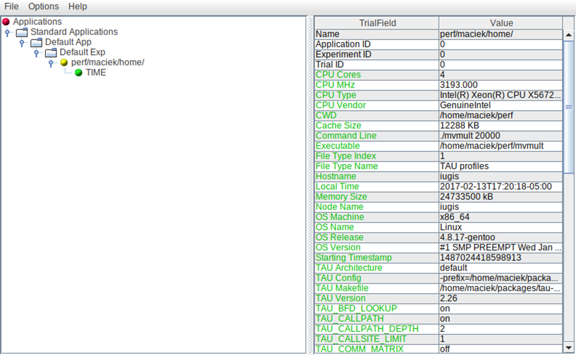
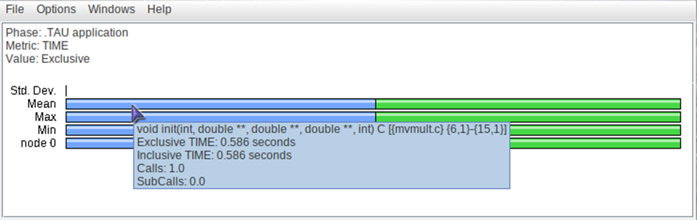
Visualization with Paraprof
Main
window
Execution
phases
window

Slide 27
VampirTrace
Open source tool for profiling on distributed machines
Supports MPI, OpenMP, CUDA, OpenCL, and hybrid environments
May be invoked from third party packages (e.g., TAU, Dyninst)
API for manual instrumentation also available
Outputs information in Open Trace Format (OTF)
Visualization performed by proprietary Vampir tool or open source toolkits
Compiler wrappers are often installed on the target machine:
vtcc for C
vtcxx for C++
vtfort for Fortran

Slide 28
VampirTrace Example: MPI Ping-Pong
0001 #include <stdio.h>
0002 #include <stdlib.h>
0003 #include <unistd.h>
0004 #include "mpi.h"
0005
0006 int main(int argc,char **argv)
0007 {
0008 int rank,size;
0009 MPI_Init(&argc,&argv);
0010 MPI_Comm_rank(MPI_COMM_WORLD,&rank);
0011 MPI_Comm_size(MPI_COMM_WORLD,&size);
0012
0013 if ( size != 2 ) {
0014 printf(" Only runs on 2 processes \n");
0015 MPI_Finalize(); // this example only works on two processes
0016 exit(0);
0017 }
0018
0019 int count;
0020 if ( rank == 0 ) {
0021 // initialize count on process 0
0022 count = 0;
0023 }
0024 for (int i=0;i<10;i++) {
0025 if ( rank == 0 ) {
0026 MPI_Send(&count,1,MPI_INT,1,0,MPI_COMM_WORLD); // send "count" to rank 1
0027 MPI_Recv(&count,1,MPI_INT,1,0,MPI_COMM_WORLD,MPI_STATUS_IGNORE); // receive it back
0028 sleep(1);
0029 count++;
0030 printf(" Count %d\n",count);
0031 } else {
0032 MPI_Recv(&count,1,MPI_INT,0,0,MPI_COMM_WORLD,MPI_STATUS_IGNORE);
0033 MPI_Send(&count,1,MPI_INT,0,0,MPI_COMM_WORLD);
0034 }
0035 }
0036
0037 if ( rank == 0 ) printf("\t\t\t Round trip count = %d\n",count);
0038
0039 MPI_Finalize();
0040 }

Slide 29
VampirTrace Compilation
Using MPI compiler wrapper
Direct linking with MPI library (may require the user to provide the location of MPI header files)
Compiling with MPI instrumentation
OpenMP code compilation
vtcc –vt:cc mpicc pingpong.c
vtcc pingpong.c -lmpi
vtcc –vt:cc mpicc –vt:mpi pingpong.c
vtcc –vt:cc gcc –vt:mt -fopenmp forkjoin.c

Slide 30
Vampir Visualization
Phase diagram shows the amount of time spent in application code (red), MPI (green), and VampirTrace API (blue)
Black lines denote messages exchanged by the processes
The information is displayed individually for each process (top) and cumulatively for the entire execution (bottom left)

Slide 31
VampirTrace Example: OpenMP
0001 #include <omp.h>
0002 #include <unistd.h>
0003 #include <stdio.h>
0004 #include <stdlib.h>
0005 #include <math.h>
0006
0007 int main (int argc, char *argv[])
0008 {
0009 const int size = 20;
0010 int nthreads, threadid, i;
0011 double array1[size], array2[size], array3[size];
0012
0013 // Initialize
0014 for (i=0; i < size; i++) {
0015 array1[i] = 1.0*i;
0016 array2[i] = 2.0*i;
0017 }
0018
0019 int chunk = 3;
0020
0021 #pragma omp parallel private(threadid)
0022 {
0023 threadid = omp_get_thread_num();
0024 if (threadid == 0) {
0025 nthreads = omp_get_num_threads();
0026 printf("Number of threads = %d\n", nthreads);
0027 }
0028 printf(" My threadid %d\n",threadid);
0029
0030 #pragma omp for schedule(static,chunk)
0031 for (i=0; i<size; i++) {
0032 array3[i] = sin(array1[i] + array2[i]);
0033 printf(" Thread id: %d working on index %d\n",threadid,i);
0034 sleep(1);
0035 }
0036
0037 } // join
0038
0039 return 0;
0040 }

Slide 32
OpenMP Vampir Visualization
Data collected for execution on 8 threads

Slide 34
Debugging

Slide 35
Overview
Tracking the origin of a parallel application execution anomaly on a supercomputer is generally much more difficult than debugging a serial application.
Debugging an application on a high performance computer frequently requires a fairly detailed view of the supercomputer software and hardware stack to properly diagnose the anomaly.
Several open source and commercial debugging tools and suites have been developed to assist the debugging process.
There are several commercial parallel debuggers which support MPI and OpenMP codes.
There are several open source serial debuggers and tool suites which can be used to debug MPI and OpenMP codes. In the case of MPI, they may require attaching several serial debuggers to a simulation.
The GNU debugger provides multiple tools for debugging a code and enabling the user to step through the code and call stack as well as viewing variables and changing their values.

Slide 36
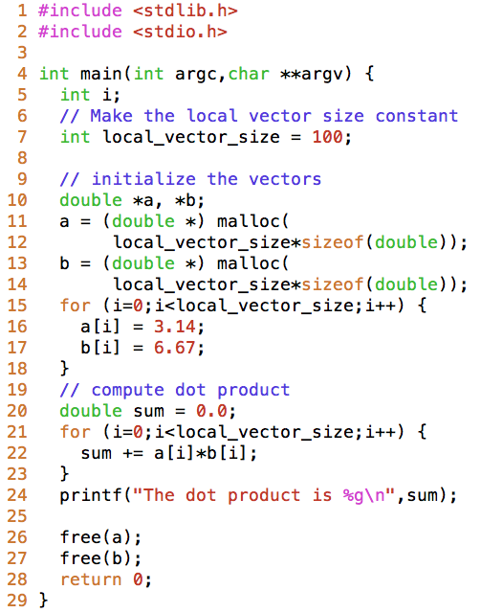
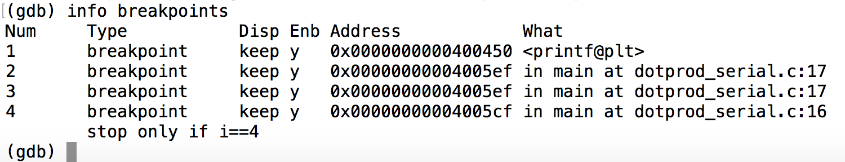
GDB Examples: breakpoints
Breakpoint Command Type | gdb breakpoint command | Description
Break by function | break printf | Pauses the execution at line 24
Break by line number | break 17 | Pauses the execution at line 17
Break by line number and filename | break dotprod_serial.c:17 | Pauses the execution at line 17
Break by conditional | break dotprod_serial.c:16 if i==4 | Pauses the execution at line 16 when i equals 4

Slide 37
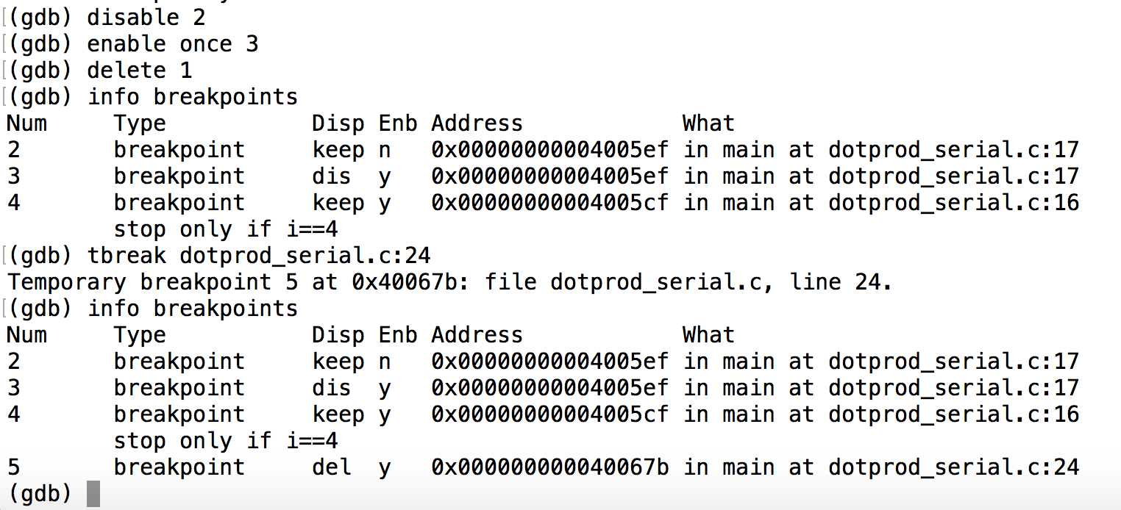
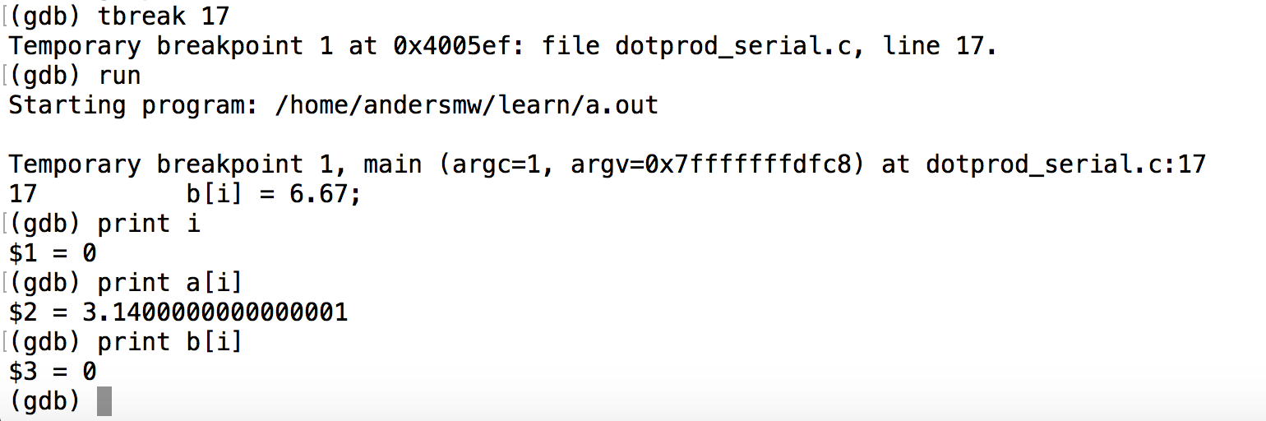
GDB Examples: enable, disable, delete, break

Slide 38
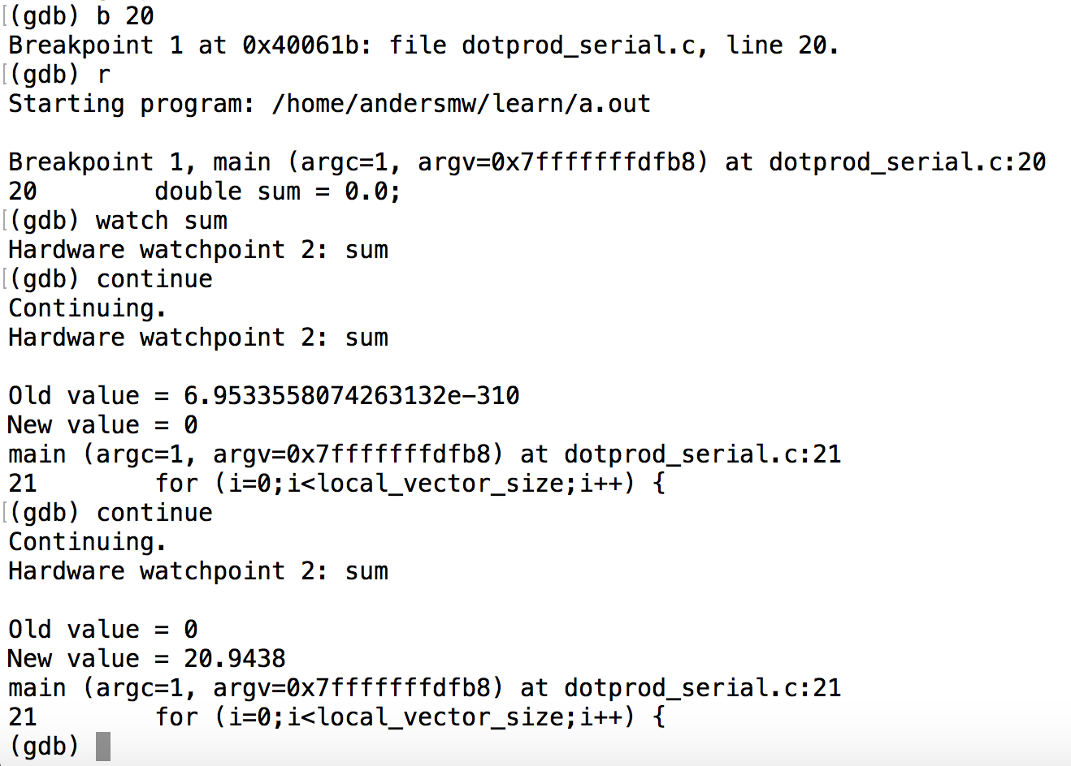
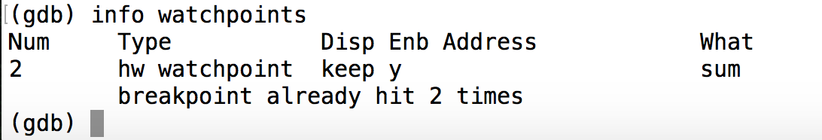
GDB Examples: Watchpoints, catchpoints

Slide 39
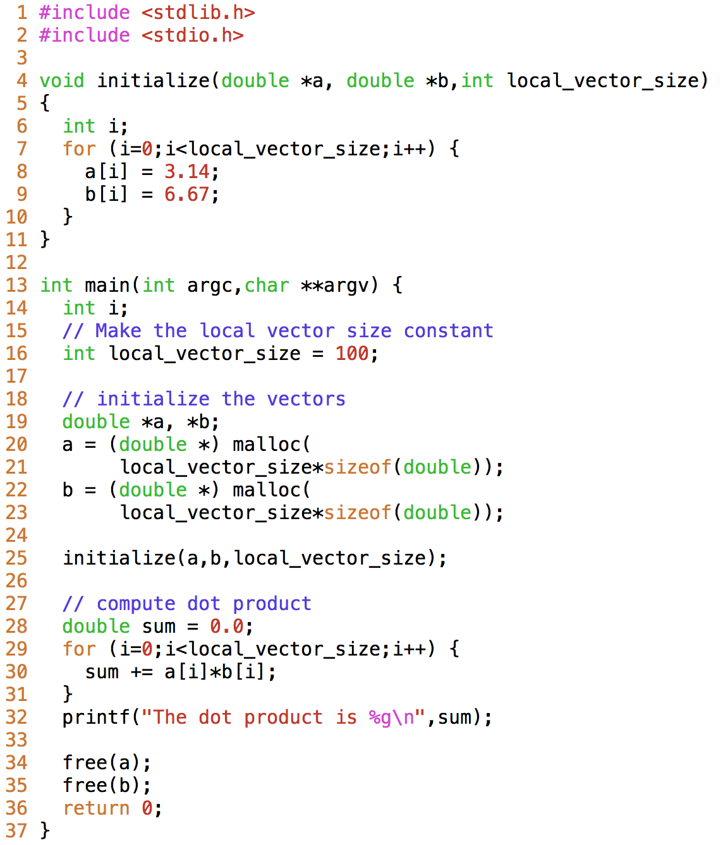
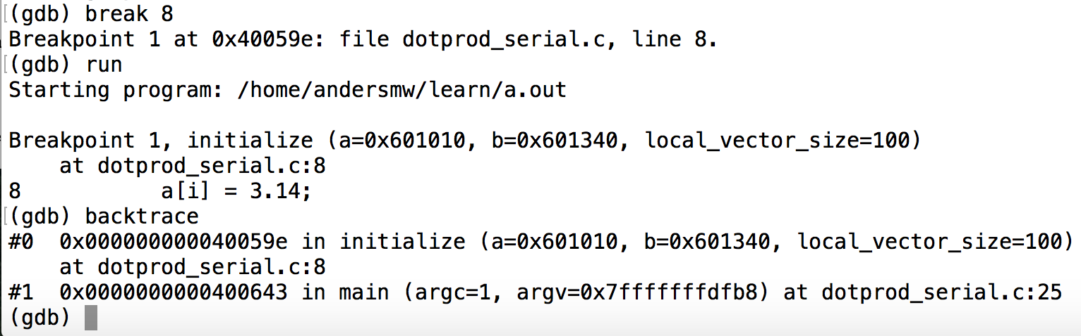
GDB Examples: Backtrace

Slide 40
GDB Cheat Sheet
Command | Abbreviation | Function
run | r | Begins execution in the debugger
continue | c | Continues execution in the debugger after a pause
quit | q | Quits the debugger
break | b | Sets a breakpoint
watch |  | Sets a watchpoint
backtrace | bt | Prints the call stack
set variable | set var | Sets a variable value
thread | t | Switches to a different thread identifier
list | l | Lists source code near the present stopping point

Slide 41
Commercial Debuggers
Commerical Debugger | Notable Capabilities
TotalView (4) | Support for OpenMP, MPI, OpenACC, CUDA
Allinea DDT (2) | Support for OpenMP, Pthreads, MPI, CUDA
Intel Parallel Debugger (5) | Support for multicore debugging

Slide 42
Tools in the Valgrind suite
Tool | Description
Memcheck | Reports memory errors, including memory leaks or access to memory that is not yet allocated.
Cachegrind | Identifies the number of cache misses.
Callgrind | Extends cachegrind with some additional information.
Massif | Heap profiler.
Helgrind | Debugger for finding data race conditions.
DRD | Multithread debugging for C and C++ programs.

Slide 43
Compiler Flags for Debugging
Action | gcc | icc | clang | pgcc
Enable pointer bounds checking (R) | -fcheck-pointer-bounds | -check-pointers-mpx=rw |  | -Mbounds
Enable address sanitizer (R) | -fsanitize=address |  | -fsanitize=address
Enable thread sanitizer (R) | -fsanitize=thread |  | -fsanitize=thread
Enable leak sanitizer (R) | -fsanitize=leak |  | -fsanitize=leak
Enable undefined behavior sanitizer (R) | -fsanitize=undefined |  | -fsanitize=undefined
Enable all common warning types (S) | -Wall | -Wall | -Wall | -Minform=warn
Warn if the code does not strictly comply with ANSI C or ISO C++ (S) | -pedantic |  | -pedantic | -Xa
Warn on use of uninitialized variables (S) | -Wuninitialized | -Wuninitialized | -Wuninitialized
Warn when local variable shadows another variable (S) | -Wshadow | -Wshadow | -Wshadow
Warn if comparison between signed and unsigned integer may produce wrong result (S) | -Wsign-compare | -Wsign-compare | -Wsign-compare
Warn if undefined identifier is used in preprocessor directive (S) | -Wundef |  | -Wundef
Warn when undeclared function is used or declaration doesn’t specify a type (S) | -Wimplicit | -Wmissing-declarations -Wmissing-prototypes | -Wimplicit

Slide 44
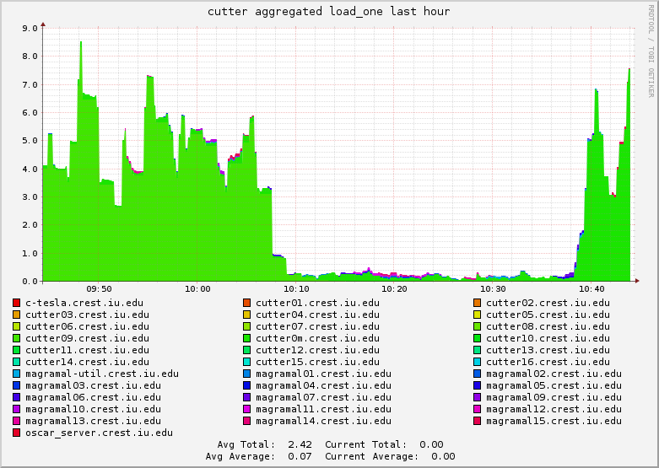
System Monitors to Aid Debugging
Ganglia

